Slide 1



Helm Charts 101

Slide 2


helm -n agenda list
Problematic - ﺔﯿﻟﺎﻜﺷاﻹ
Engineering Behind Helm - ﻢﻠﻟﮭﺔﯿﺳﺪﻨﮭاﻟﺔﯿﺿراﻷ
Concepts: Helm vs Chart vs Release – ﻢﯿھﺎ
High Level Architecture – ﻲﻠﻜﯿﮭاﻟﻢﯿﻤﺼﺘاﻟ
Helm Basic commands – ﻢ ﺬﯿﻔﺗﻨﺮﻣا
Deal with Community Charts - +1000 charts – تاﺮﺗﺸﻢ ﻣﻊﻞﻣﺎﻌﺘاﻟ
Implement your own Chart -ﺑﻚﺔﺻﺎﺨاﻟترﺎﺸﺘاﻟﻦاﺑ
Demo ( distributed ) - ﻲﻠ ﯿﻖﺒﺗﻄ

Slide 3
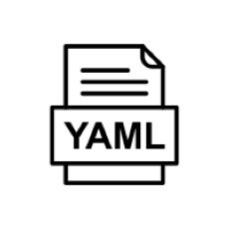
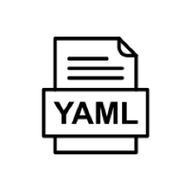
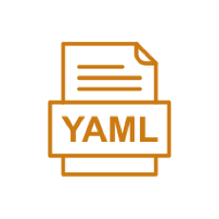
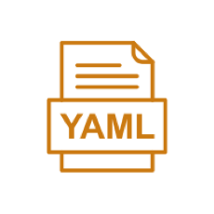
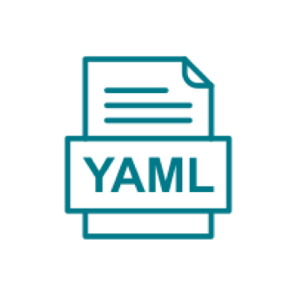
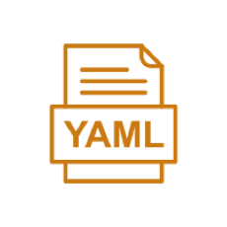
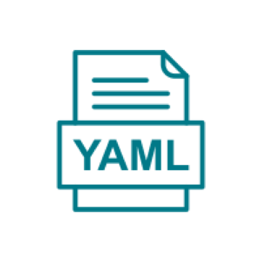
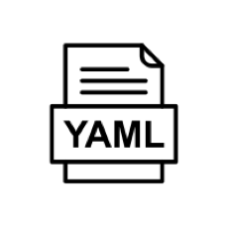
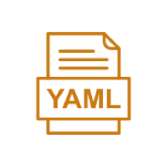

Problematic- ﺔﯿﻟﺎﻜﺷاﻹ
App 1
App 2
Your App = Not Only image
App = Image + YAML files
A lot of YAML files
ﻞﻣﺎﯿاﻟﻰﺿﻓﻮ
Hard Coded Manifests
Repeating Your Self
ﻊﯾزﻮﺘاﻟوﺮﺸﻨاﻟﺔﺑﻮ
Hard Distribution
No versioning
nodeJs + Postgres
Go + Postgres

Slide 4
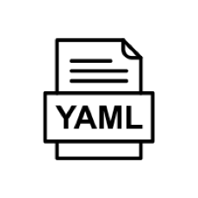
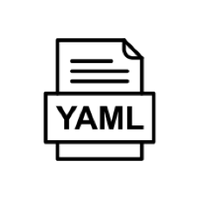


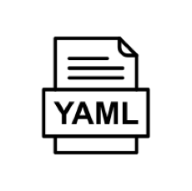
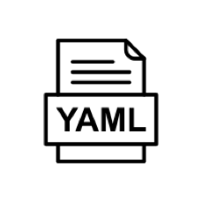
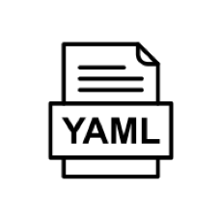
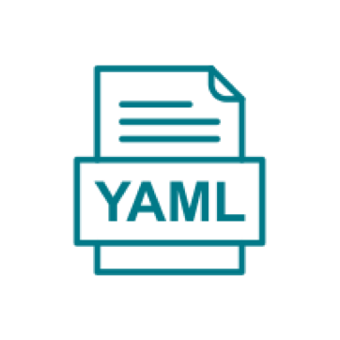
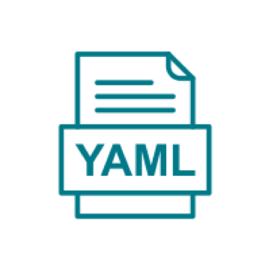
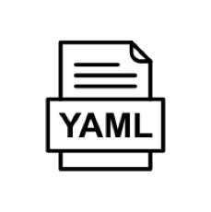
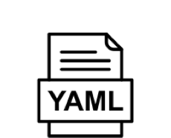
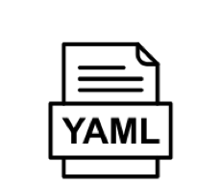
Problematic
Pods
App X
Just Deploying YAML
No Business Domain
No Boundries
<K get pods>
<K get PVC>
No <k get apps>
What about namespaces
No package Manager for k8s apps
Services
ConfigMap

Slide 5
Engineering Behind Helm - ﻢﻠﻟﮭﺔﻤﻋاﺪاﻟﺔﺳﺪـﻨ
Release Engineering – قﻼطاﻹﺔﺳﺪ
Software Engineering – تﺎﯿﺠﻣﺮﺒاﻟﺔﺳﺪ
Reliability Engineering – ﺔﯿﻗﻮﺛﻮﻤاﻟﺔﺳﺪ

Slide 6
Engineering Behind Helm - ﻢﻠﻟﮭﺔﻤﻋاﺪاﻟﺔﺳﺪـﻨ ﻟا
Release Engineering
Software Engineering
Reliability Engineering
Package a Software
Easily install Dependencies
Track of what software installed
Yaml
Code
Package Manager
Upgrade installed software
Manage versions
....

Slide 7
Engineering Behind Helm - ﻢﻠﻟﮭﺔﻤﻋاﺪاﻟﺔﺳﺪـﻨـﮭاﻟ
Release Engineering
Software Engineering
Reliability Engineering
Deployment Env.
Code
Build & Deploy
Build & push
Pull & deploy
Artifact Package
V1.3 V1.4

Slide 8
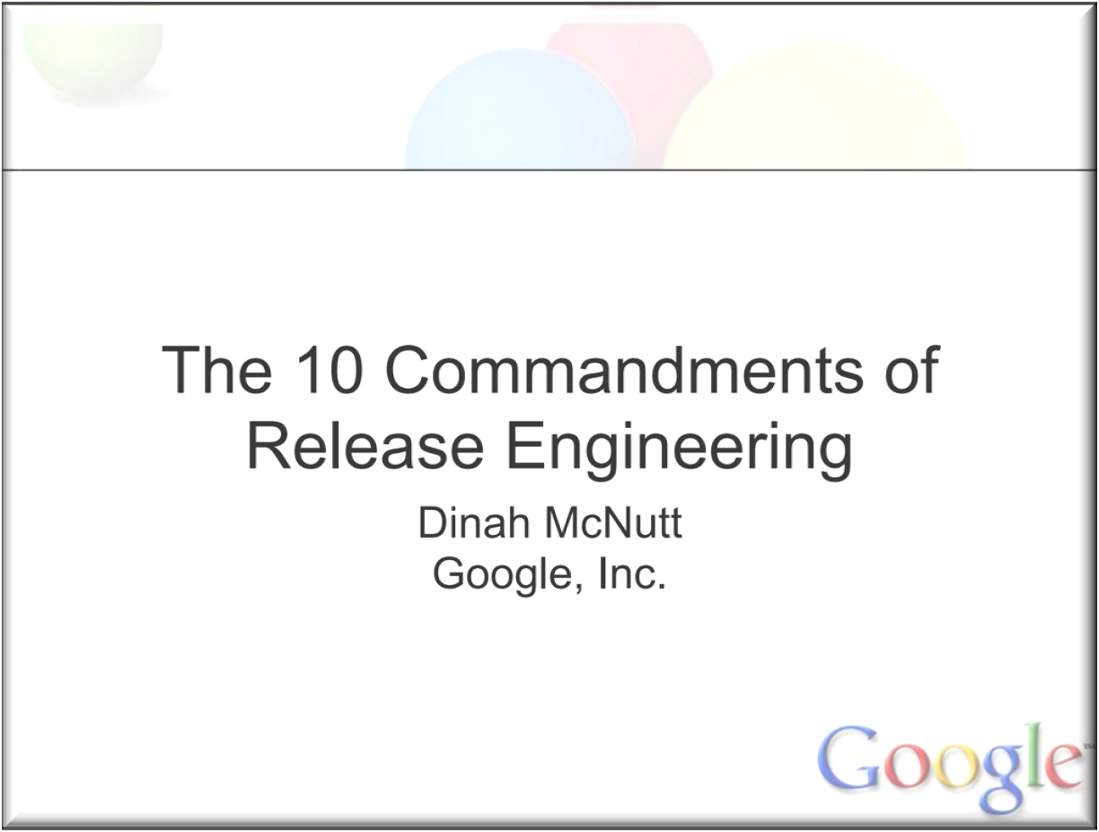
Engineering Behind Helm - ﻢﻠﻟﮭﺔﻤﻋاﺪاﻟﺔﺳﺪـﻨـﮭاﻟ
Release Engineering
Software Engineering
Reliability Engineering
Event - RELENG 2014

Slide 9
Engineering Behind Helm - ﻢﻠﻟﮭﺔﻤﻋاﺪاﻟﺔﺳﺪـﻨـﮭاﻟ
Release Engineering
Software Engineering
Reliability Engineering
DRY – Don’t Repeat Yourself
Reusability
Modularity
Clean Code
Design Patterns
- ….

Slide 10
Engineering Behind Helm - ﻢﻠﻟﮭﺔﻤﻋاﺪاﻟﺔﺳﺪـﻨ
Release Engineering
Software Engineering
Reliability Engineering
Codify ALL and ALL Operations
Why ? Code Don’t Lie == Reliability
- Codify ALL and ALL Operations
- Why ? Code Don’t Lie == Reliability
- Code vs Adhoc Scripting
- Code vs Adhoc Scripting:
Code is controlled by version control system
Code is elegant, readable, maintainable
Code is tested & quality gates must be passed.
Code means Code-Review is enabled thru pull- requests, then, risks/bugs are mitigated
Code means you can continuously integrate your
Changes thru CI/CD pipeline.

Slide 11
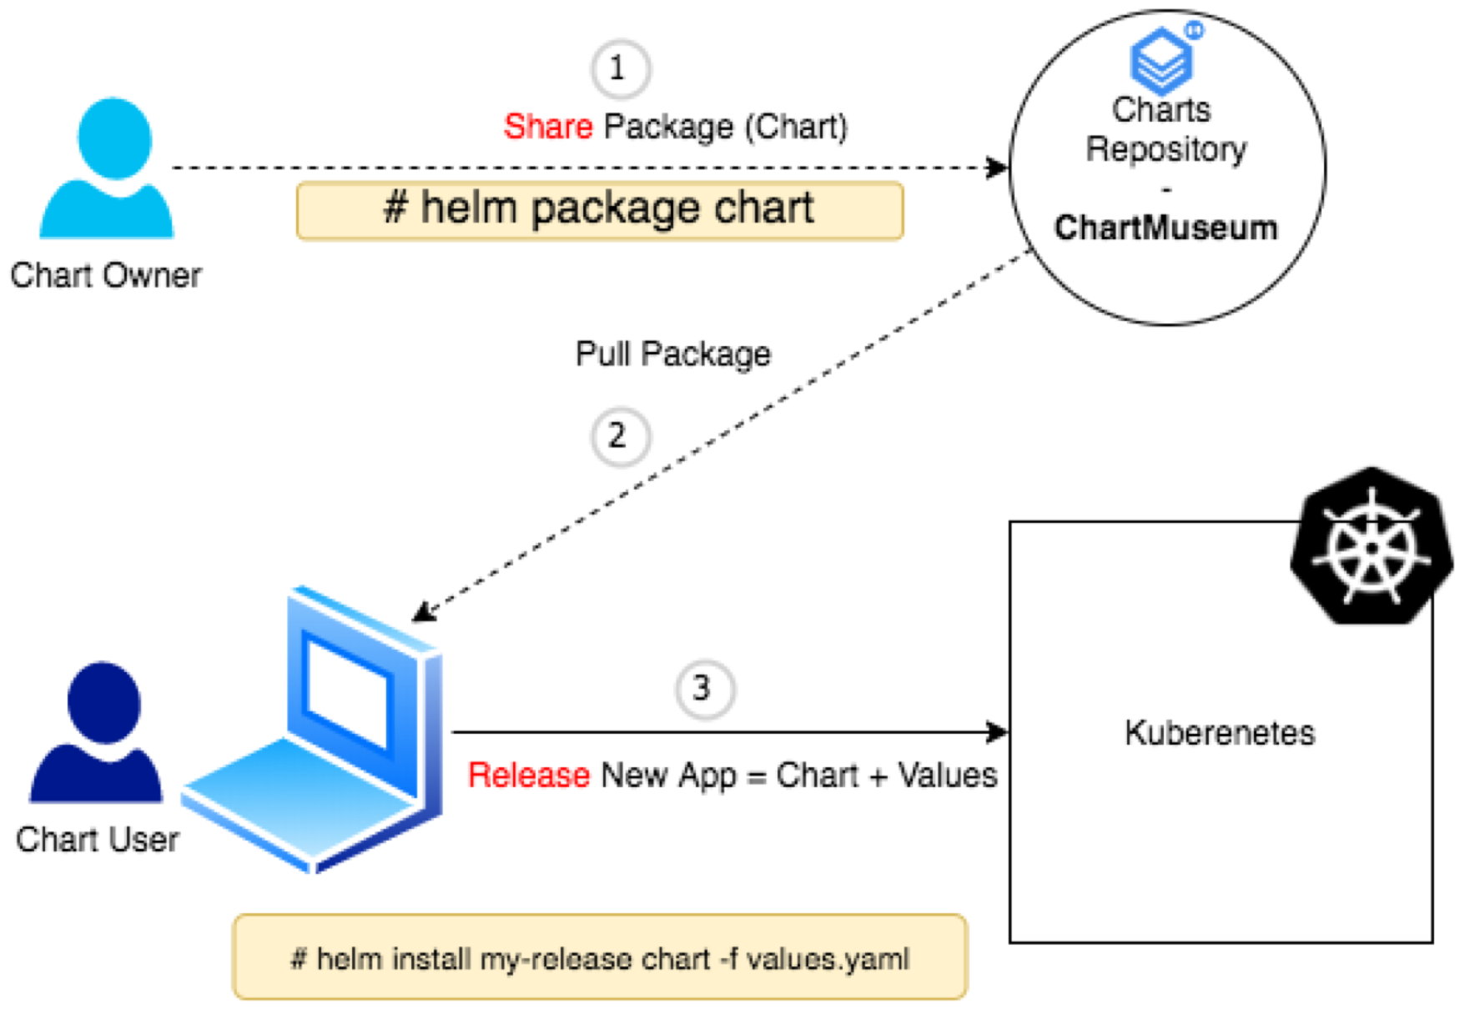
What’s Helm ? - ؟ ﻢ ھﻮﻣﺎ
Package Manager for k8s Apps
Manage the lifecycle of any
application deployed on k8s cluster
Engine to calculate the final YAML Code from YAML templates + Params (values)

Slide 12
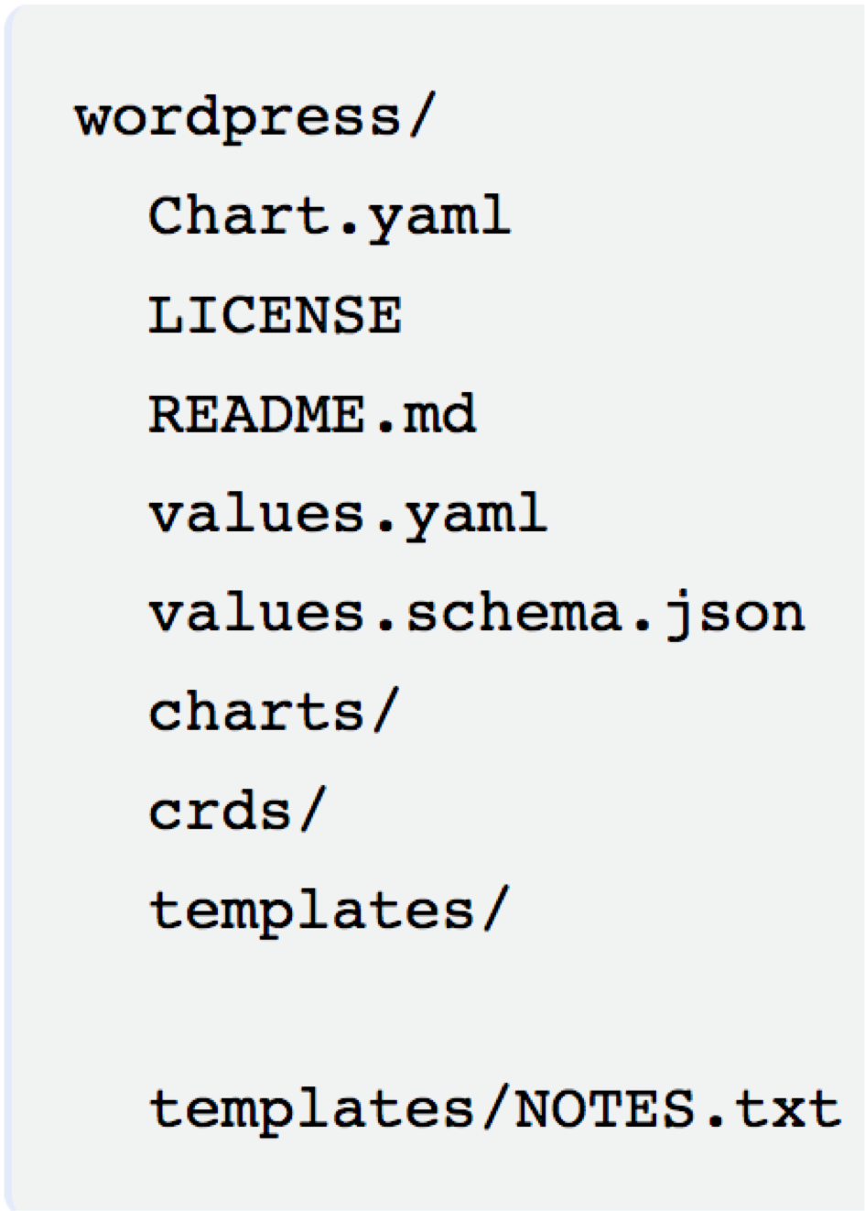
What’s Helm Chart ? - ؟ ﻢ ھﻮﻣﺎ
The package Format is called “Chart” or “Helm Chart”
A chart is a collection of files that describe a related set of k8s resources.
Repository of Charts is called “Chartmuseum”

Slide 13

What’s Helm Release ?
- Helm Chart is deployed with customizing default Values.
- Each deployment of Helm Chart is called
Helm Release

Slide 14

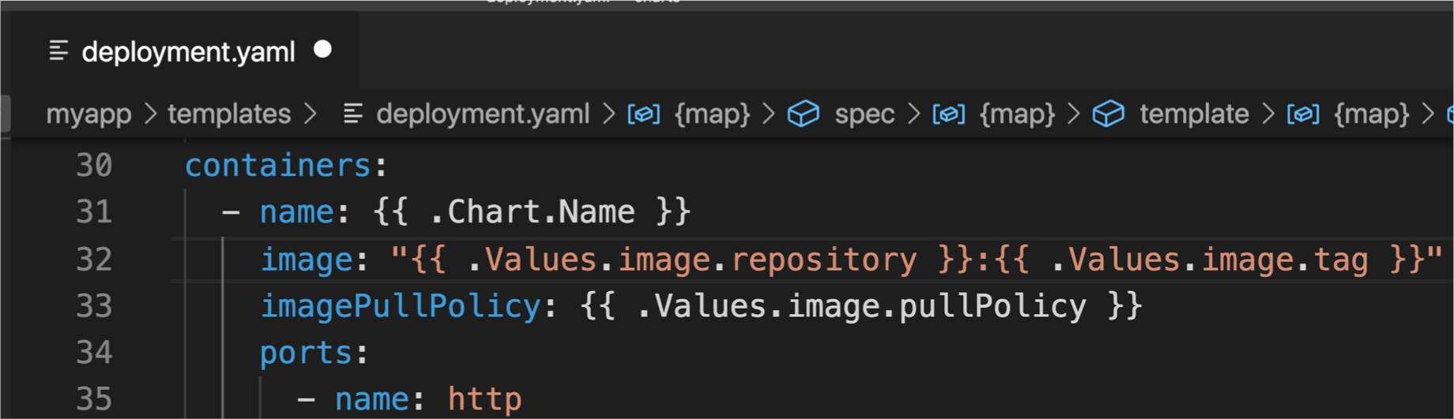

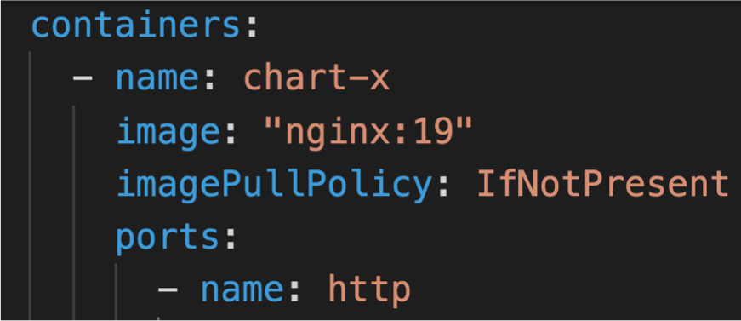
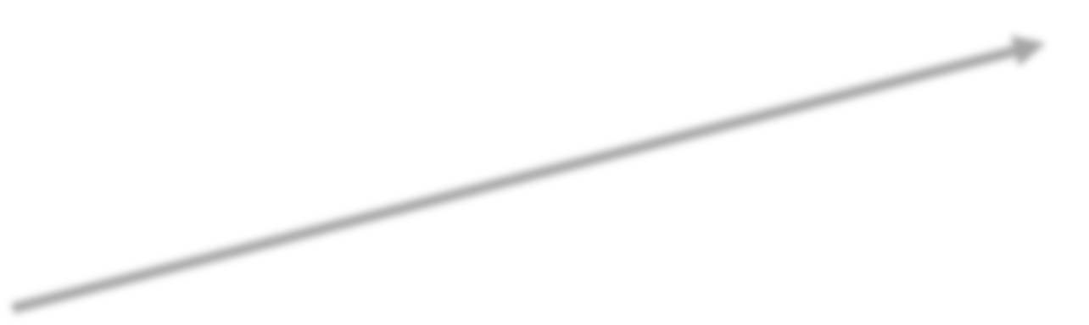
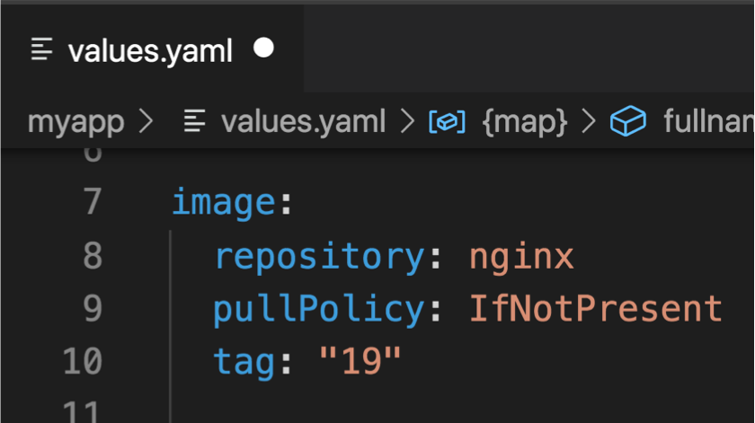
How Does Helm Work ? – ﻞﻐﺘ ﻒﻛﯿ
- Chart Templates ( i.e : chart/templates/deployment.yaml )
Final YAML Manifest
- Chart Default Values

Slide 15

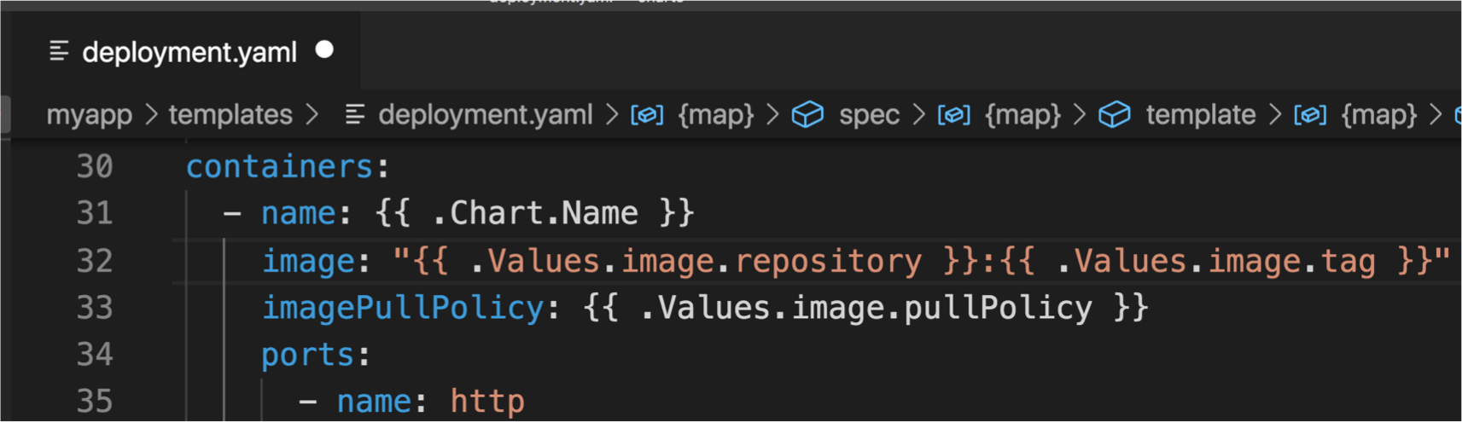
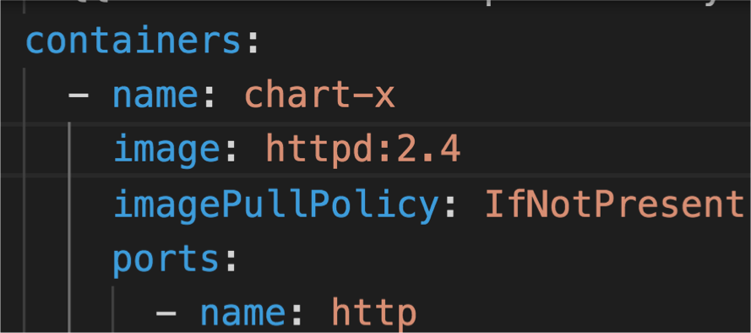


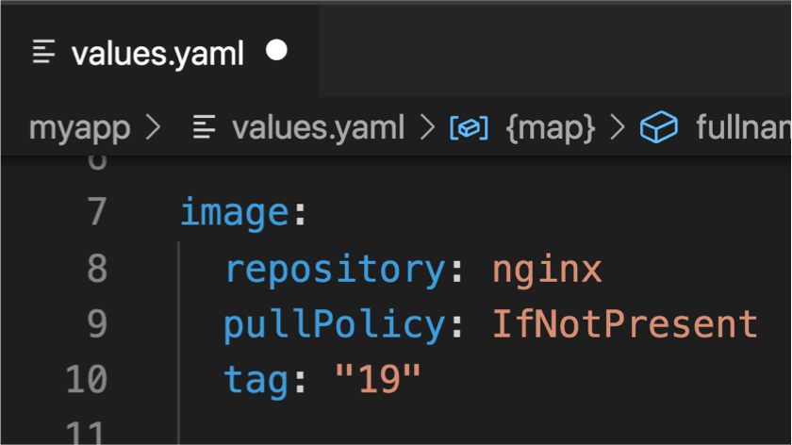
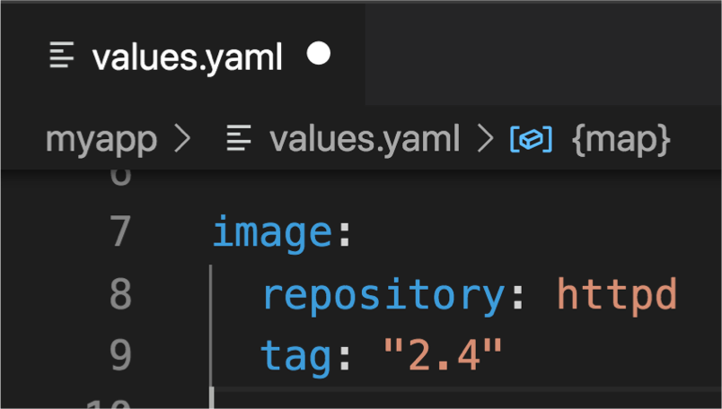
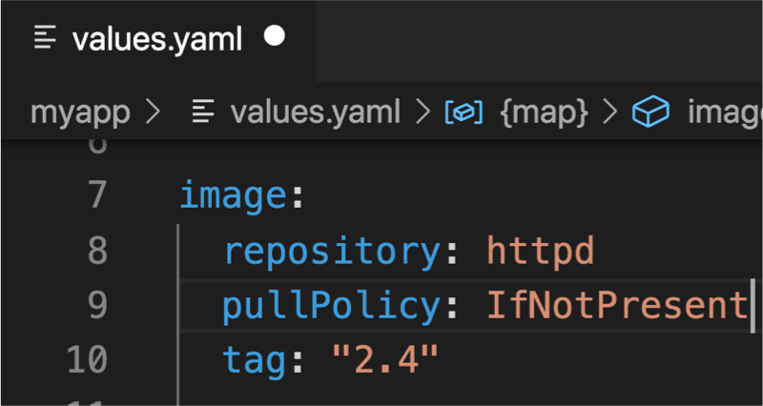

How Does Helm Work ? – ﻞﻐﺘ ﻒﻛﯿ
- Chart Templates ( i.e : chart/templates/deployment.yaml )
Final YAML Manifest
- Chart Default Values
- Release Values ( My values)
Final Values

Slide 16
Steps to install Chart on Kubernetes Cluster
Having a Kubernetes Cluster
Download/install Helm CLI locally https://helm.sh/docs/intro/install/
Identify Repository of Chart (museum)
Install The Chart with specific version & values
Inspect Values/Docs of Chart
Prepare Your Values for the Release
Stable
Incubator
…
hub.helm.sh
Values.yaml
README.MD
Prod.values.y aml
Staging.values
.yaml
helm install my- release repo/chart
–version v1.2 -f my.values.yaml

Slide 17

Hands-on – Install Jenkins with Helm Chart
helm install jenkinsci/jenkins --version 2.6.2

Slide 18
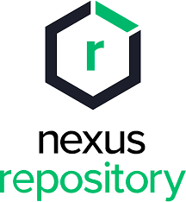
Hands-on – Install Nexus Sonatype with Helm Chart
helm install sonatype/nexus-repository-manager --version 27.0.0

Slide 19

Helm Commands
helm install RELEASE REPO/CHART_NAME [--version … –f .. –n .. ]
Helm Install
helm install jenkins-staging jenkinsci/jenkins --version 2.6.2
helm upgrade RELEASE REPO/CHART_NAME [--version … –f .. –n .. ]
Helm Upgrade
helm upgrade jenkins-staging jenkinsci/jenkins --version 2.6.2
helm delete RELEASE
Helm Delete
helm delete jenkins-staging
helm template RELEASE REPO/CHART_NAME [--version … –f .. –n .. ]
Helm Template
helm template jenkinsci/jenkins --version 2.6.2

Slide 20

Helm Commands For Repo
helm repo add REPO REPO_ENDPOINT
Helm repo add
helm repo add stable https://kubernetes-charts.storage.googleapis.com
helm repo update
Helm repo update
helm repo update
Helm repo list
Helm repo list
helm repo list
Helm search [repo|hub] CHART
Helm search
Helm search repo elasticsearch

Slide 21
Steps to Implement Own Helm Chart
Scaffold a Chart Directory
Put your Yaml Manifests in Templates Directory
cp *.yaml my- chart/template s/
Use Your Chart
Externalize Values with a consistent design
helm create
My-
chart/values.y aml
helm install my- release ./my-chart -f other.values.yaml

